Slide 1
PSCS TRAINING FOR DEANS/ ACAD COORDINATORS
May 10, 2018
Joanadiane C. Jardin
Curriculum Development Unit
AMAES Academic Affairs Department

Slide 2
1-2-3 Check!
1 minute
2 person (pair)
3 info
How’s your morning?
What did you learn from yesterday’s training?
What do you expect to learn today?
Check!
Class Schedule Creation
Class Block Creation
Etc.

Slide 3
Roles and Responsibilities
Academic function and tasks
Strictly implement the approved curricula by Academic Affairs.
CODE (Create, Observe, Deliver, Encode)
Strictly follow the approved Academic Calendar

Slide 4
Grading System
Lecture Class Only
Preliminary Grade 20%
Midterm Grade 20%
Pre-final Grade 20%
Final Grade 40%
Breakdown of the grade for every term period
Quizzes 40%
Class Participation
(projects, assignments, recitation, attendance) 10%
Major Exam 50%
Lecture Grade 100%

Slide 5
Classes with Laboratory
FINAL GRADE = 20%(Prelim Grade) + 20%(Midterm Grade) + + 20% (Prefinal Grade) + 40%(Final Grade)
TERM GRADE = 60%(Lecture Grade) + 40%(Laboratory Grade)
Lecture Grade per term
Quizzes 40%
Class Participation
(projects, assignments, recitation, attendance) 10%
Major Exam 50%
Lecture Grade 100%
Laboratory Grade per term
Experiments (minimum of 2) 40%
Class participation 20%
Major Exam 40%
Laboratory Grade 100%

Slide 6
AMAES SHS Gradebook are based on DEPED Order No. 8 s. 2015 on grading policy
The grade in each subject area are based on 3 grading criteria and weighted accordingly.
Grading system are applied differently (weight of grading criteria) based on type of subjects

Slide 7
AMA Basic Education Curriculum SY 2018-2019 Grade 11 & Grade 12 Grading Policy (Based on DepEd Order No. 8 s. 2015)

Slide 8
Written Work (ASSESS LEARNERS’ UNDERSTANDING OF CONCEPTS AND APPLICATION OF SKILLS IN WRITTEN FORM)
Chapter test
Quizzes
Essays
Written Reports
Data recording and analyses
Surveys
Problem sets
Lab reports & documentation
Reflection papers

Slide 9
Performance Tasks (INVOLVE STUDENTS IN THE LEARNING PROCESS INDIVIDUALLY OR IN COLLABIRATION WITH TEAMMATES OVER A PERIOD OF TIME; GIVE STUDENTSOPPORTUNITIES TO DEMONSTRATE AND INTEGRATE THEIR sk.u.s ABOUT LESSONS LEARNED IN REAL-LIFE SIT BY PERFFORMING; GIVE STUDENTS THE FREEDOM TO EXPRESS THEIRLEARNING )
Class Standing
Recitation
Attendance
Learning Activity Sheets
Literary analyses/multimedia production & presentation/ projects/prototype buildings/debates/skills presentation/ action plan preparation & presentation/musical research/song analysis/art criticism/exhibit/projects/art production/physical activity participation/oral tests/design, creation, and layout of outputs/diagnose and repair equipment

Slide 10
Quarterly assessment
Synthesis of all learning skills, concepts & values learned in an entire quarter

Slide 11
CORE
25 %
50 %
ACADEMIC TRACK
25 %
30 %
TVL/SPORTS/ ARTS & DESIGN TRACK – IMMERSION
ACAD TRACK-IMMERSION
35 %
20 %
25 %
45 %
40 %
25 %
60 %
20 %
TVL/SPORTS/ ARTS
& DESIGN TRACK
20 %
60 %
20 %

Slide 12
AMAES ENHANCED GRADING SYSTEM

Slide 13
AMAES Blended Learning
College Blended Learning (CBL)
Lecture: 50% F2F + 50% OED
Laboratory: Full F2F
SHS Blended Learning
50% F2F + 50% OED

Slide 14
Effective SY 2016-2017, AMAES Senior High is implementing the Blended learning/teaching delivery mode and the 50% Online - 50% Face to Face grading policy.
A student must have FINAL GRADE of at least 75 to pass a subject and must have a FINAL GRADE of at least 75 in ALL learning areas in a semester to proceed to the NEXT SEMESTER.

Slide 15
Actual matrix for K11/K12 CORE SUBJECTS grade setup using SHS ABLE Gradebook Portal.
Core Subject | 50% Online | 50% Face to face | Initial Grade | Quarter Grade
Quarter 1 | 25% of Written work 50% of Performance Task 25% of Quarterly Exam | 25% of Written work 50% of Performance Task 25% of Quarterly Exam | IgradeQ1 | Q1grade
Quarter 2 | 25% of Written work 50% of Performance Task 25% of Quarterly Exam | 25% of Written work 50% of Performance Task 25% of Quarterly Exam | IgradeQ2 | Q2Grade
Final Grade = 50 % Q1Grade (transmuted) + 50% Q2 Grade (transmuted) = or (Q1 + Q2)/2

Slide 16
The Equivalency Matrix
AMACC vs NON-AMACC Course Code Matrix
CBL Content Matrix
SHS Matrix
GE Matrix (for crediting)
Bridging (for non SHS grad and Returnee)
Old and New GE (for release)

Slide 17
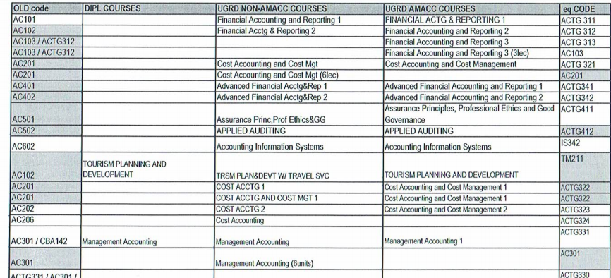

Slide 18
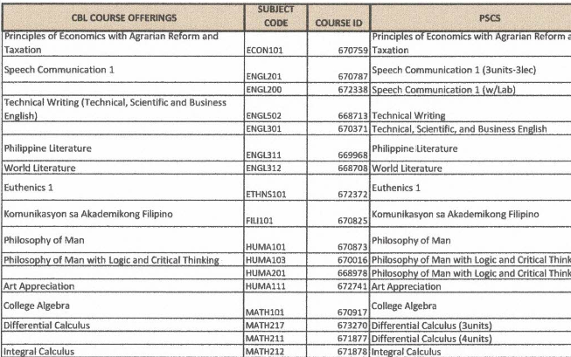

Slide 19
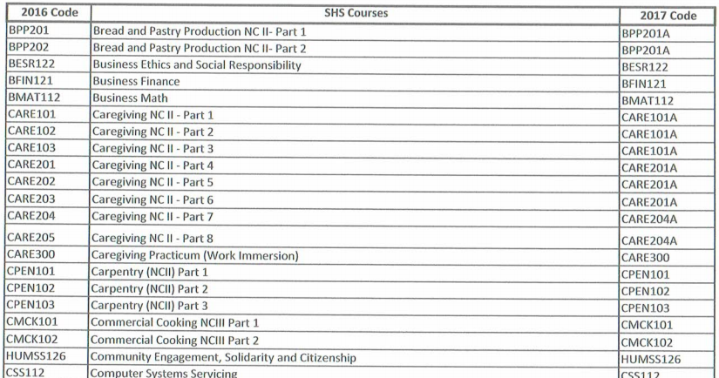

Slide 20
OLD GE |  | NEW GE
Communication Skills 1 |  | Purposive Communication
Communication Skills 2 |  | Purposive Communication
Speech Communication 1 |  | Purposive Communication
Komunikasyon sa Akademikong Filipino |  | Wika, Lipunan at Kultura
Pagbasa at Pagsulat Tungo sa Pananaliksik |  | Kritikal na Pagbasa, Pagsulat at Pagsasalita
Masining na Pagpapahayag |  | Pagsasaling Pampanitikan
Art Appreciation |  | Art Appreciation
Philippine Literature |  | Readings in Philippine History
Philosophy of Man |  | Understanding the Self
College Algebra |  | Mathematics in Modern World
Statistics and Probability |  | Mathematics in Modern World
Life & Works of Jose Rizal |  | Life & Works of Jose Rizal
PE 1-4 |  | PE 1-4
NSTP 1-2 |  | NSTP 1-2
Euthenics 1 -2 |  | Euthenics 1 -2

Slide 21
Oral Communication in Context | Purposive Communication
English for Academic and Professional Purposes
Understanding Culture, Society and Politics | Philippine Popular Culture
Earth Science | Science, Technology and Society
Earth and Life Science
Physical Science
Introduction to the Philosophy of the Human Person/Pambungad sa Pilosopiya ng Tao | Understanding the Self
General Mathematics | Mathematics in Modern World
Statistics and Probability
Contemporary Philippine Arts from the Regions | Art Appreciation
Pagsulat sa Filipino sa Piling Larangan | Kritikal na Pagbasa, Pagsulat at Pagsasalita
Komunikasyon at Pananaliksik sa Wika at Kulturang Pilipino | Wika, Lipunan at Kultura
Personal Development/Pansariling Kaunlaran | Ethics
Media and Information Literacy | Living in IT Era
Empowerment Technologies (E-Tech): ICT for Professional Tracks
Pagbasa at Pagusuri ng Iba’t Ibang Teksto Tungo sa Pananaliksik | Pagsasaling Pampanitikan
21st Century Literature from the Philippines and the World | Readings in Philippine History
Entrepreneurship | The Entrepreneurial Mind
Reading and Writing Skills
Practical Research 1
Practical Research 2
Inquiries, Investigations and Immersion
 | Life and Works of Rizal
 | The Contemporary World

Slide 22
References
All relevant DepEd Orders
DO 08, s. 2015
DO 36, s. 2016
DO 30, s. 2017
DO 11, s. 2018
All important CMOs
PSGs
Philippine Qualifications Framework (PQF)
TESDA Curricular 038, 2017

Slide 23
Reports
Functions + and RPT 2

Slide 24
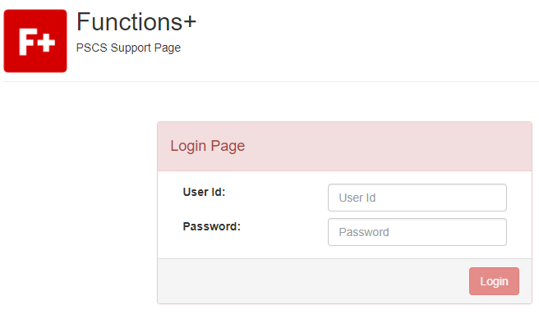
Functions + (link can be found in oracle support page)
http://oraclecampus.amaes.edu.ph/

Slide 25
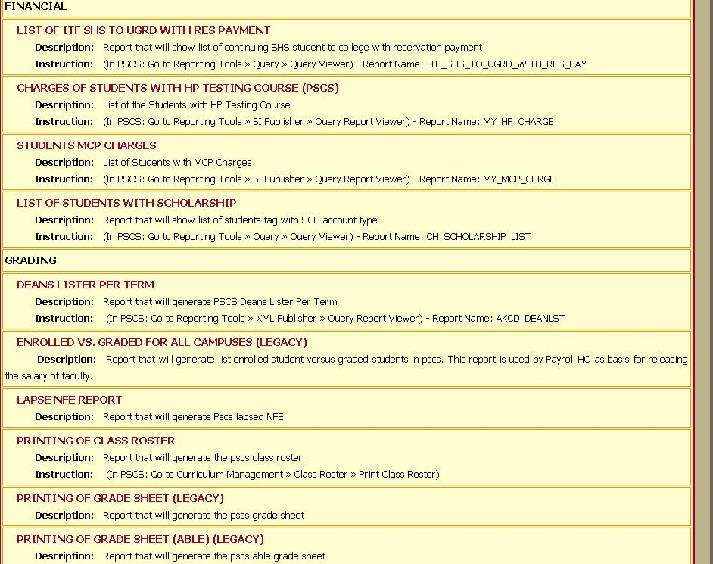
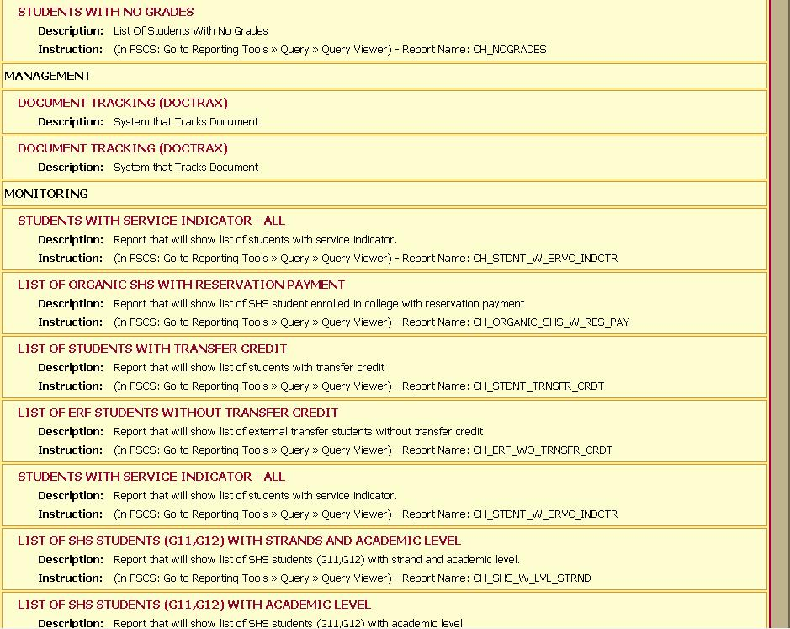
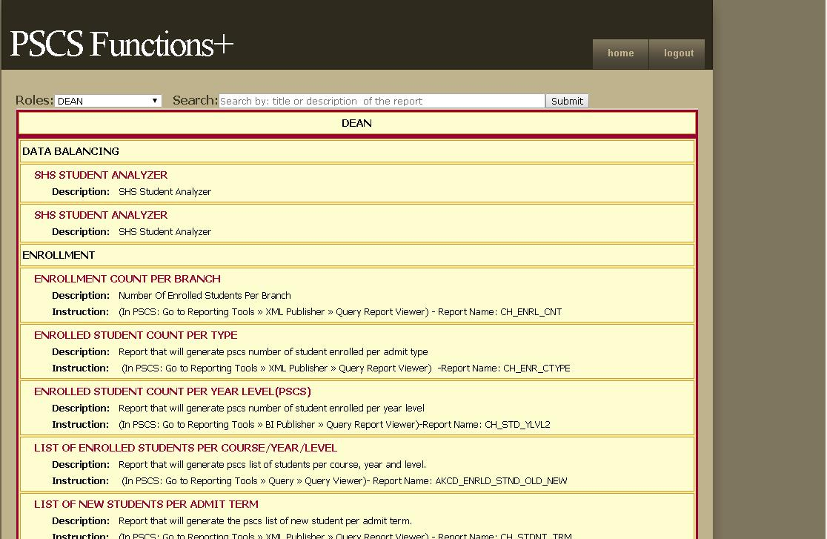
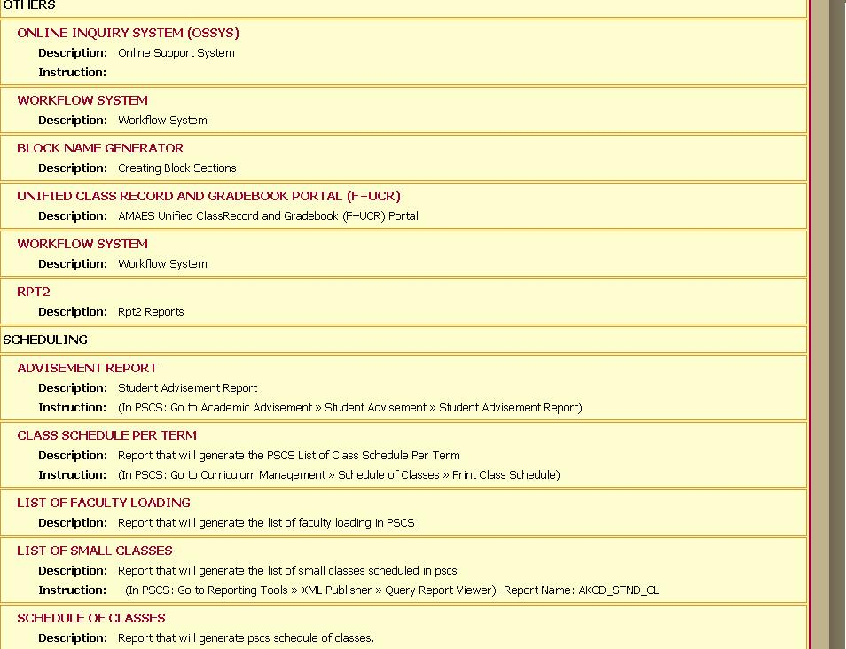
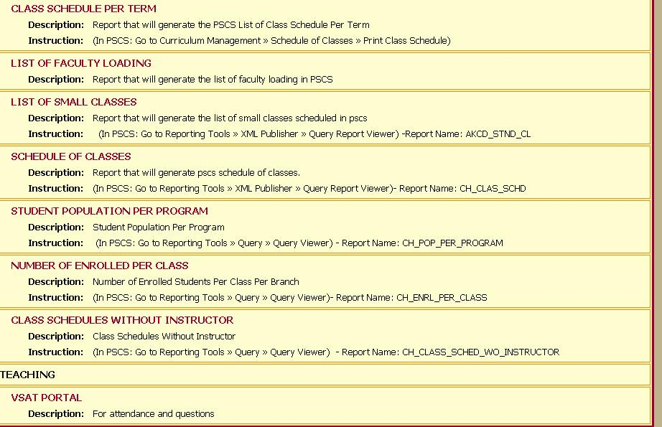
Can View

Slide 26
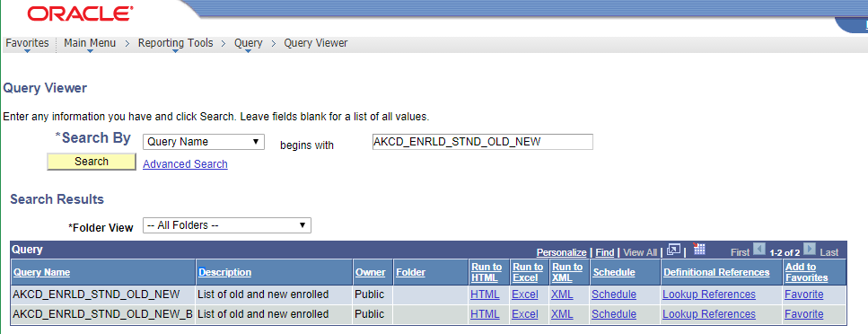
How to Interpret

Slide 27
RPT 2
http://usn.amaes.edu.ph/stepreports/alpha.asp
This Special Reporting Menu of Functions+ will allow you to quickly check data inconsistencies and help us monitor branch performance. The information here may be used in conjunction with PSCS and PSCS Functions+. This entire reporting system works on the assumption of the 6 Step Stage classification of students.

Slide 28
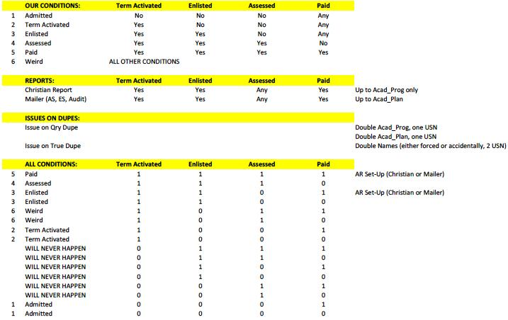
6 Step Stage classification of students

Slide 29
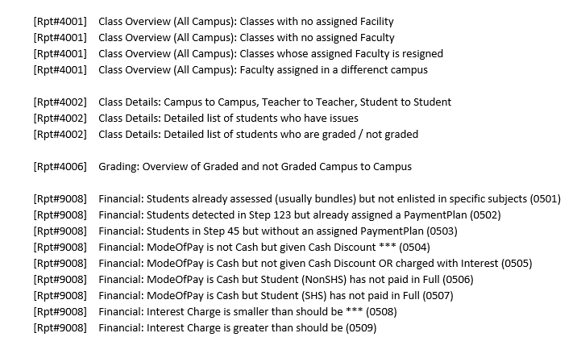
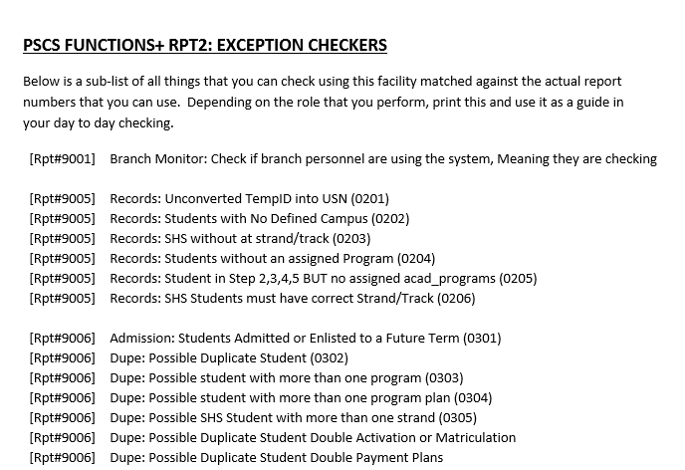
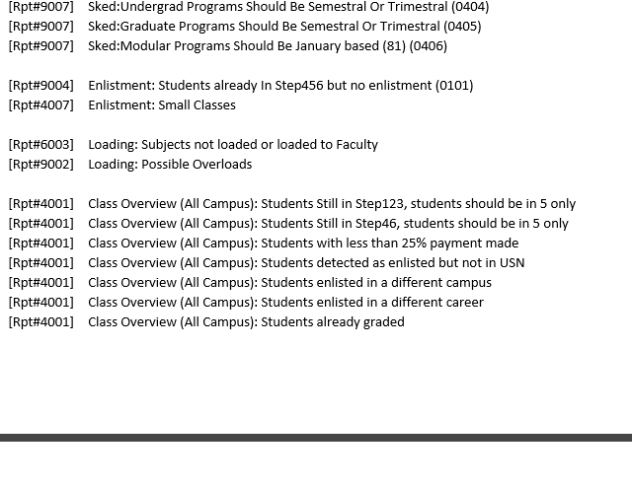
Can View

Slide 30
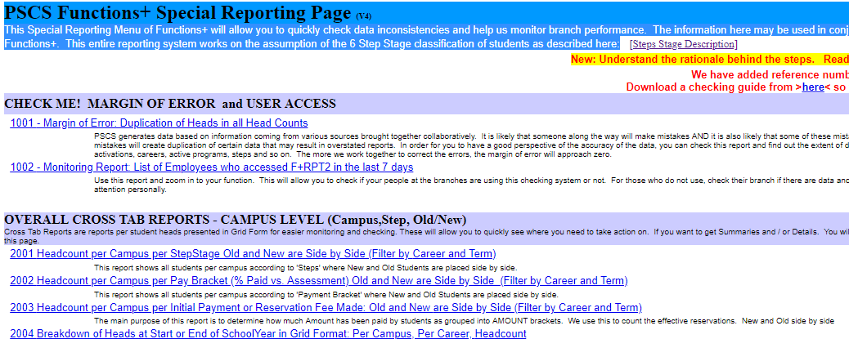

Slide 31
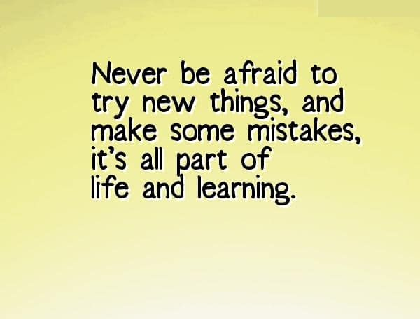
Any Question?

Slide 32
jcjardin@amaes.edu.ph
Thank you!

